Slide 1
Viewing Transformations
Nancy Victor
Assistant Professor
SITE, VIT University,
Vellore

Slide 2
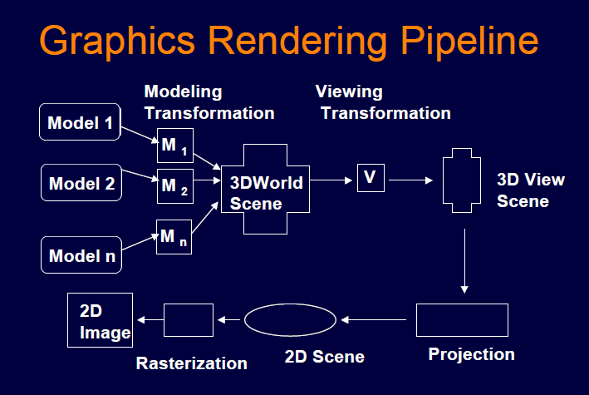
Graphics Rendering Pipeline

Slide 3
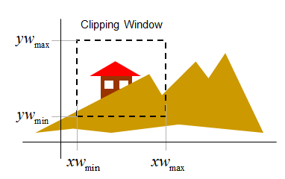
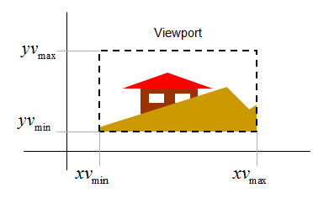
Introduction

Slide 4
Introduction
The selected portion of a picture in world co-ordinate for display is called window.
An area on the display device to which a window is mapped is called a viewport.
The window defines what is to be viewed and the viewport determines where it is to be displayed.
The method of selecting and enlarging a portion of the drawing is called windowing.
The technique of hiding that part of the drawing one is not interested in is called as clipping.

Slide 5
Viewing Transformation
The mapping of a part of a world coordinate scene to device coordinates is referred to as viewing transformation.
The 2D viewing transformation is simply referred to as window-to-viewport transformation or the windowing transformation.
It actually involves more than just the transformation from window to viewport.

Slide 6
2D Graphics: Coordinate Systems
□ Screen coordinate system
Pixels
□ World coordinate system
Scene space
□ World window
View of the scene
□ Viewport
Drawing of the view of the scene
□ Window-to-viewport mapping

Slide 7
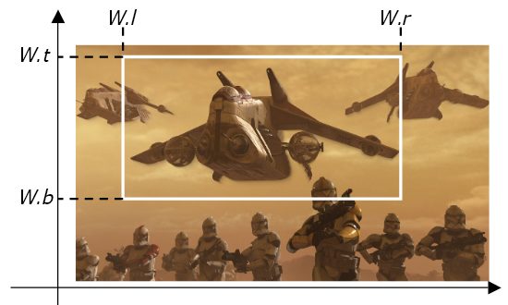
Definition of a World Window
World window
  Rectangular region of drawing (in world coordinates) to be
drawn
Defined by
  W.l
  W.r
  W.b
  W.t

Slide 8
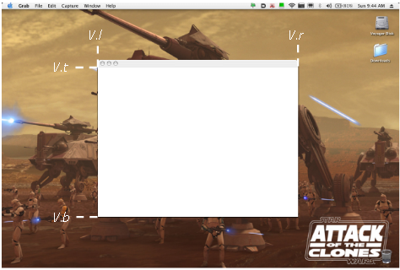
Definition of a Viewport
Rectangular region of the screen used to display drawing
Defined in screen coordinate system

Slide 9
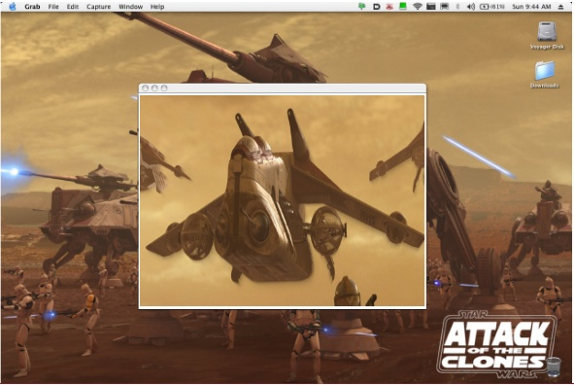
Window-to-Viewport Mapping

Slide 10
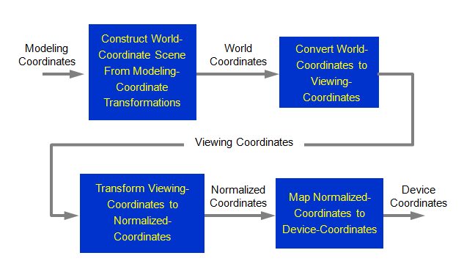
Viewing Transformation

Slide 11
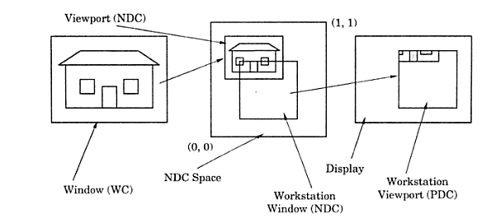
Viewing Transformation

Slide 12
Viewing Transformation
The transformation from world coordinates to device coordinates occurs in two steps:
1. Normalization Transformation: Describes the coordinate system of a virtual display device with the coordinates in the range of a unit square.
Workstation Transformation: The transformation from NDC to Device coordinates. It allows a portion only of the viewport to be placed upon the device drawable area in a position chosen by the application.

Slide 13
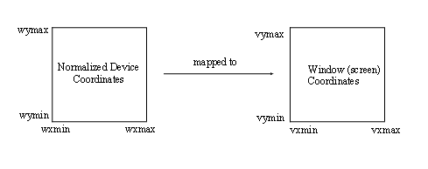
Windowport to Viewport Transformation

Slide 14
Windowport to Viewport Transformation
fx=Vxmax-Vxmin / Wxmax-Wxmin
fy= Vymax-Vymin / Wymax-Wymin
Transformation Factor, f is:
if fx<fy, f=fx, otherwise f=fy.
Let Vx=Vxmax,Wx=Wxmax,Vy=Vymax,Wy=Wymax.
Then, f=Vx-Vxmin/Wx-Wxmin and
f=Vy-Vymin/Wy-Wymin
Therefore, Vx=Vxmin+f(Wx-Wxmin) and Vy=Vymin+f(Wy-Wymin)
So, Vx and Vy are the required transformed viewport coordinates.

Slide 15
Thank You…

